Slide 1
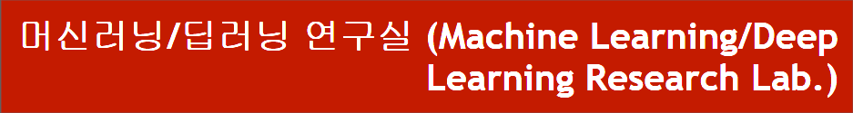
Code Analysis of DARTS
동서대학교 대학원 컴퓨터공학과
Jie Yong Shin,
Dae-Ki, Kang , Prof (advisor)
2022.02.03
Notes:
1

Slide 2
CONTENTS
1. Summary
2. Approximation
3. Code Analysis
4. Conclusion and Discussion
Notes:
2

Slide 3
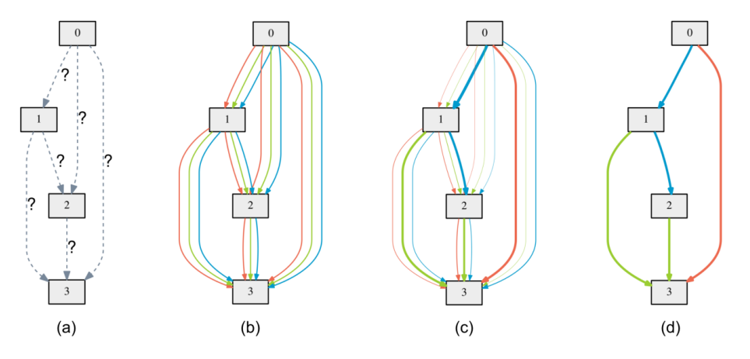
1. Summary
Define Search space as DAG(Directed Acyclic Graph)
Notes:
3

Slide 4
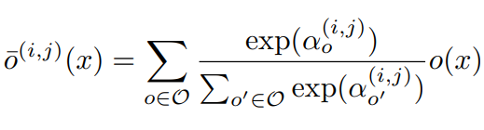
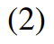
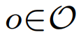
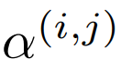
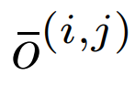
1. Summary
Example of a set O : {convolution, pooling, none}
: Weights of operations (Vector)
: Mixed operation
Notes:
4

Slide 5
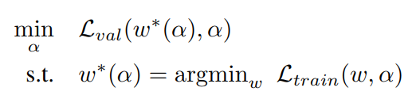
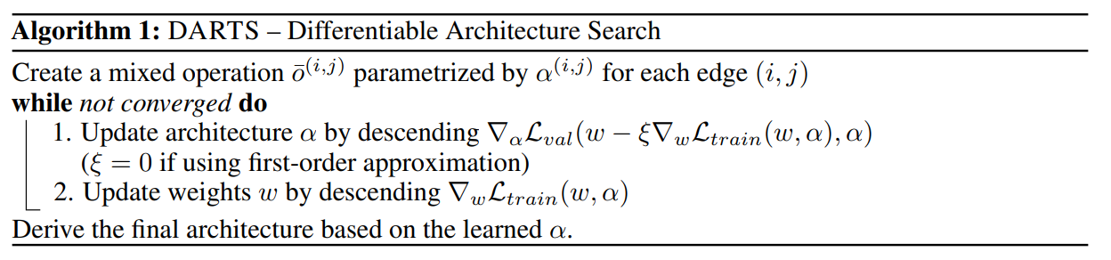
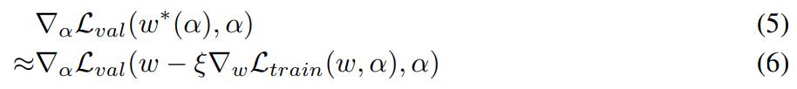
1. Summary
Loss to optimize is w of train loss and α (weight of operation) of validation loss
Notes:
5

Slide 6
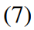
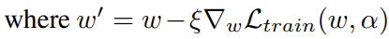
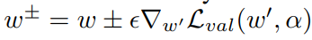
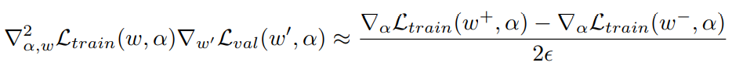
2. Approximation
Simple approximation
Applying chain rule to the approximate architecture gradient
Finite difference approximation
Notes:
6

Slide 7
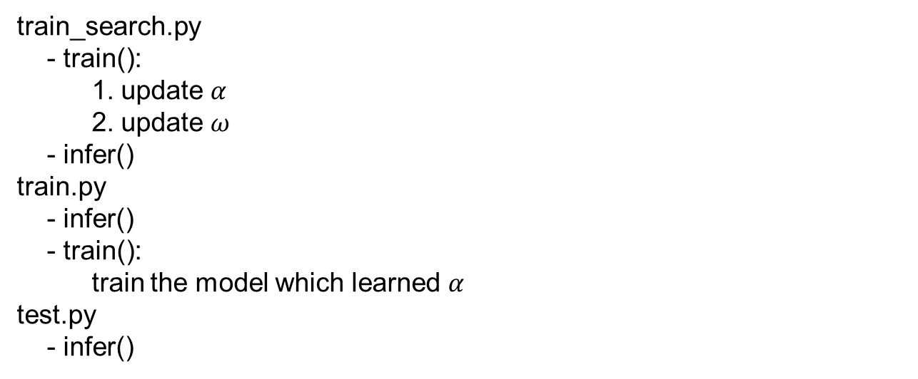
3. Code Analysis
train_search.py
- train():
1. update $α$
2. update $ω$
- infer()
train.py
- infer()
- train():
train the model which learned $α$
test.py
- infer()
Notes:
7

Slide 8
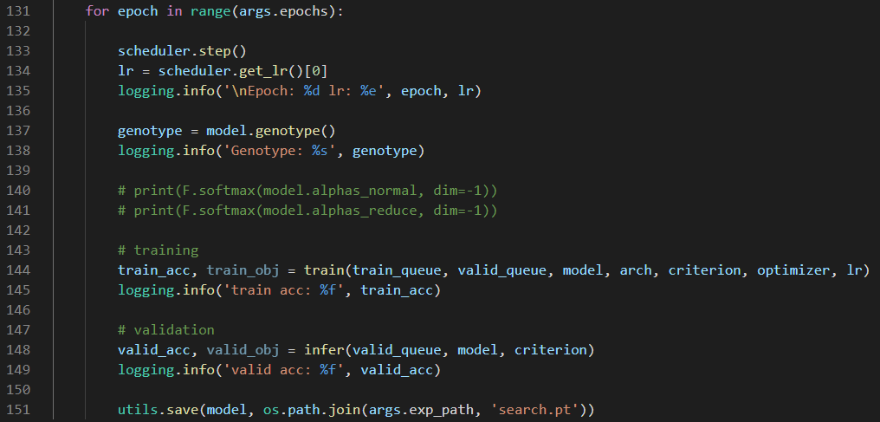
3. Code Analysis
train_search.py
Notes:
8

Slide 9
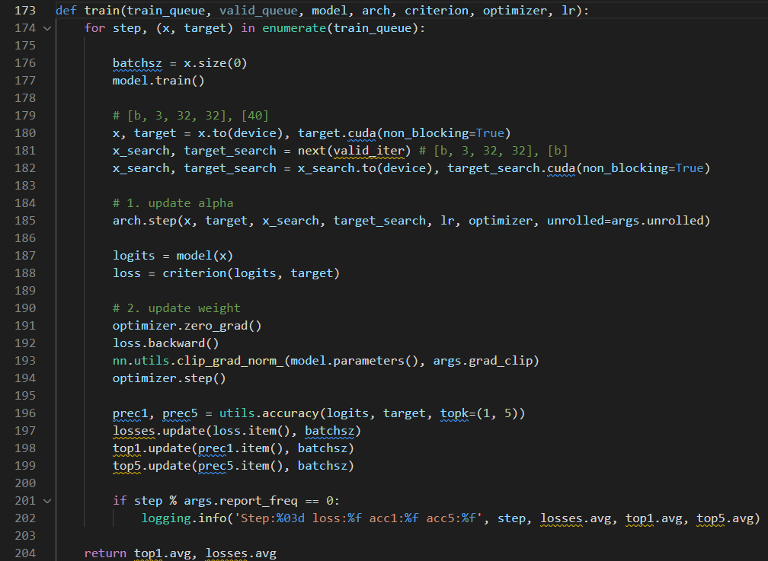
3. Code Analysis
train_search.py
Notes:
9

Slide 10
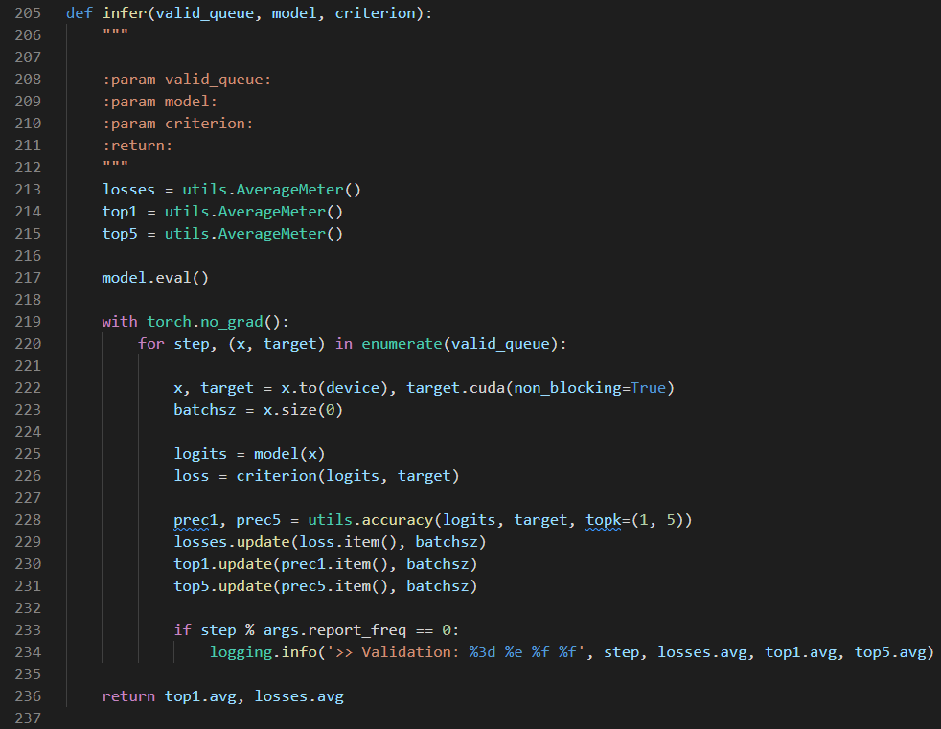
3. Code Analysis
train_search.py
Notes:
10

Slide 11
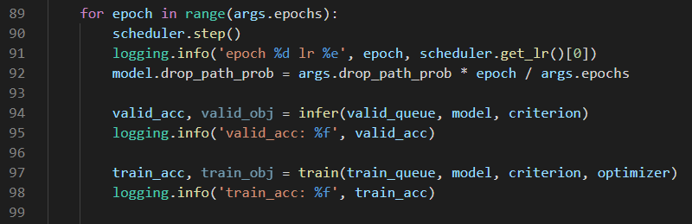
3. Code Analysis
train.py
Notes:
11

Slide 12
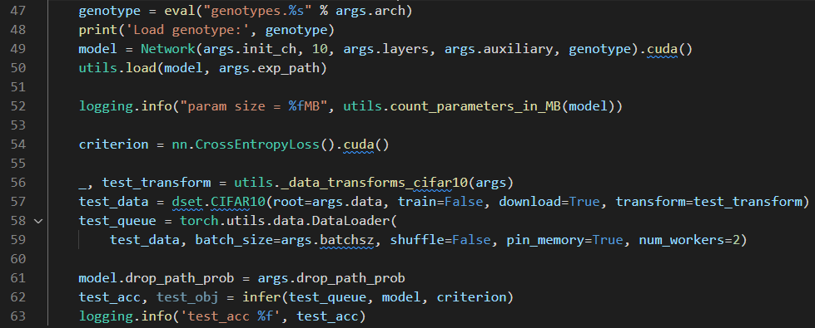
3. Code Analysis
test.py
Notes:
12

Slide 13
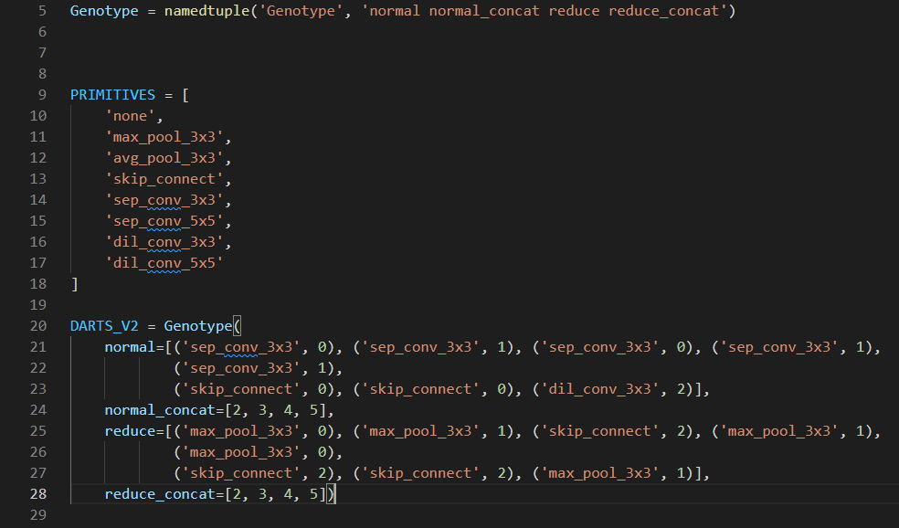
3. Code Analysis
Genotype
Notes:
13

Slide 14
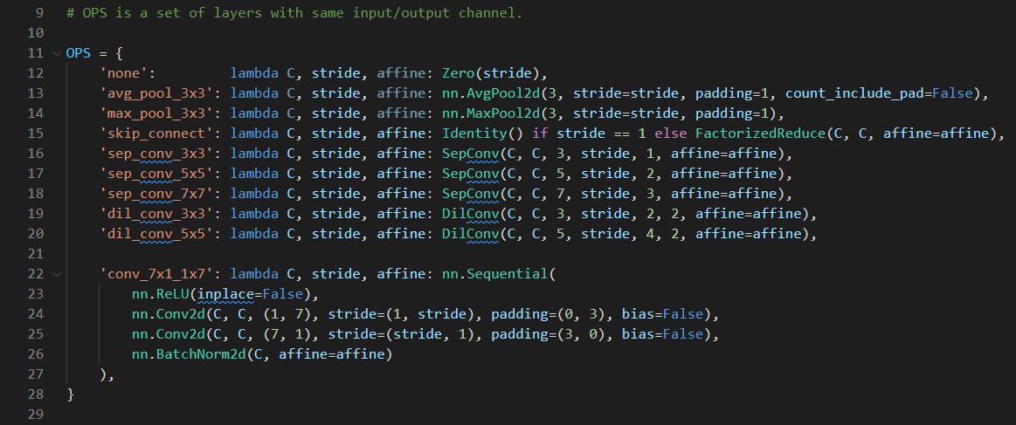
3. Code Analysis
Operators
Notes:
14

Slide 15
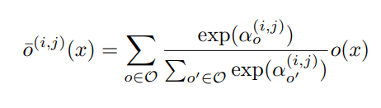
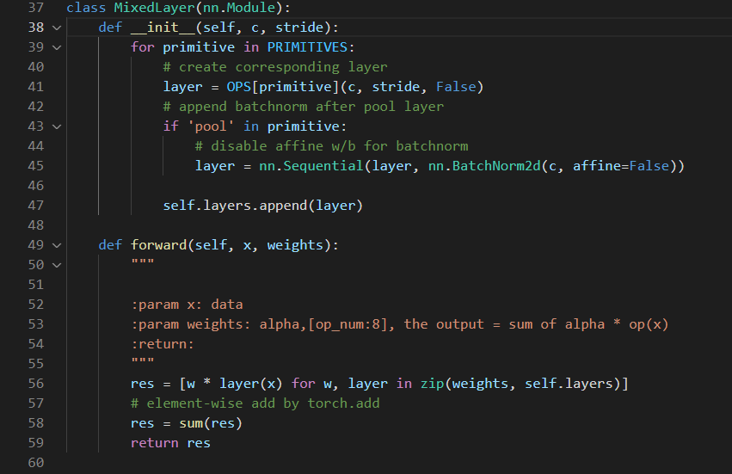
3. Code Analysis
Notes:
15

Slide 16
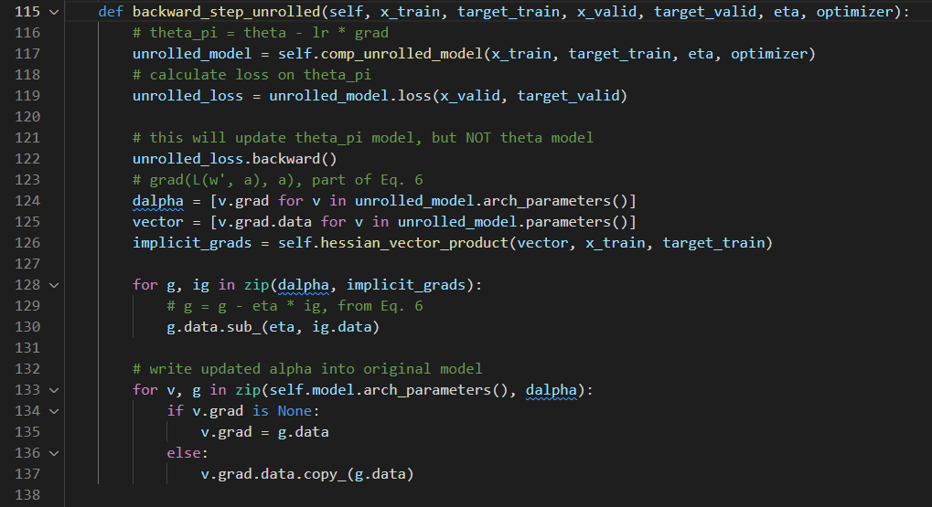
3. Code Analysis
Notes:
16

Slide 17
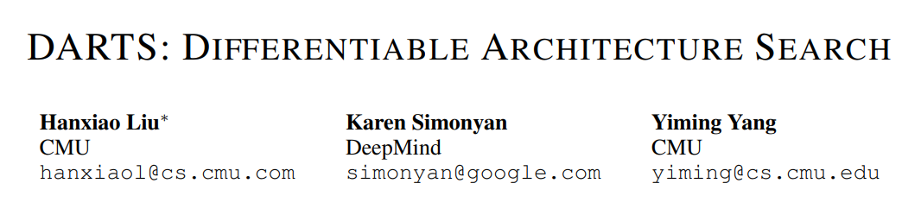
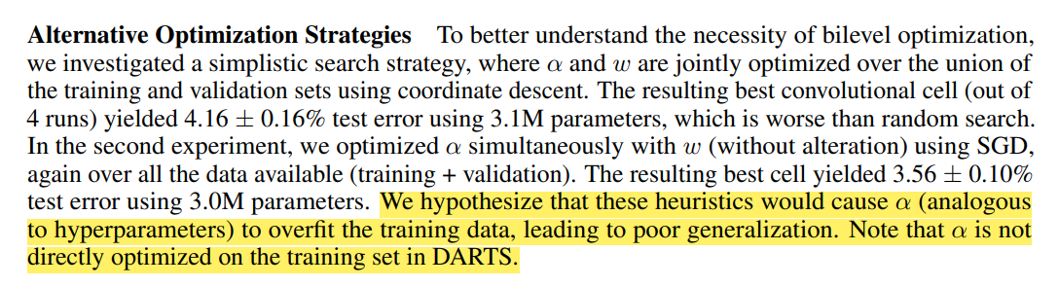
4. Conclusion and Discussion
Notes:
17

Slide 18
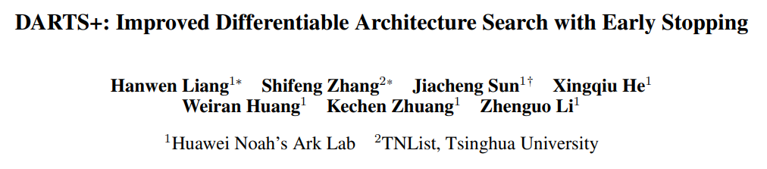
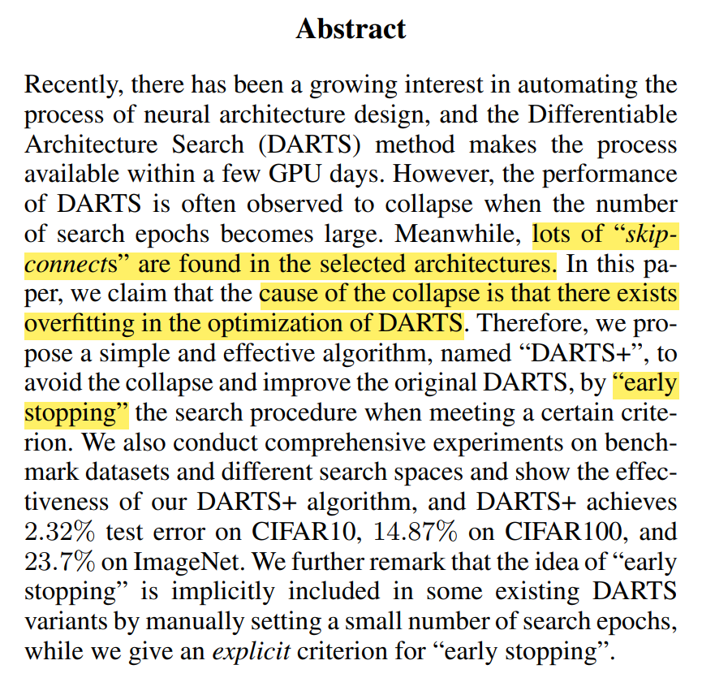
4. Conclusion and Discussion
Notes:
18

Slide 19
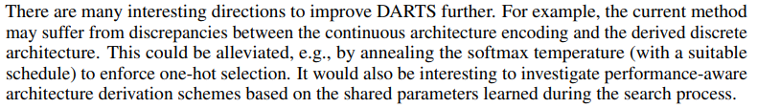
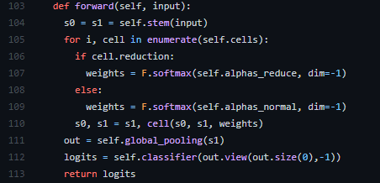
4. Conclusion and Discussion
Notes:
19

Slide 20
4. Conclusion and Discussion
Notes:
20

Slide 21
References
https://arxiv.org/abs/1806.09055
https://github.com/quark0/darts
https://github.com/dragen1860/DARTS-PyTorch
https://arxiv.org/abs/1909.06035
Notes:
21

Slide 22
감사합니다.
Q & A
22
Notes:
-
The training of procedure for is to maximize the probability of D making a mistake. This framework corresponds to a minimax two-player game.
In the space of arbitrary functions G and D, a unique solution exists, with G recovering the training data distribution and D equal to ½ everywhere.
22

Slide 23
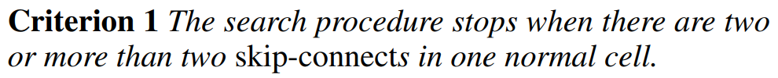
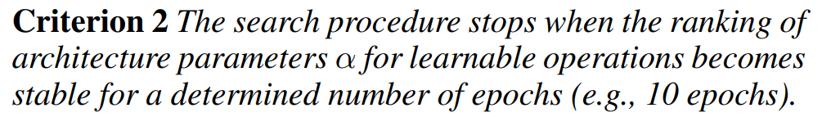
4. Conclusion and Discussion
Notes:
23

Slide 24
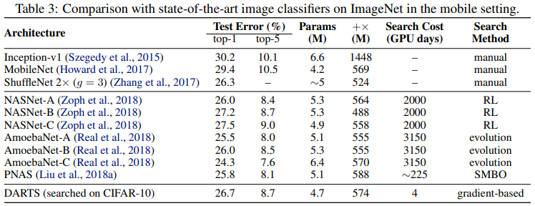
4. Results
Transfer learning with DARTS
Notes:
24

Slide 25
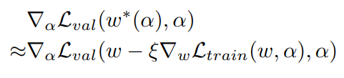
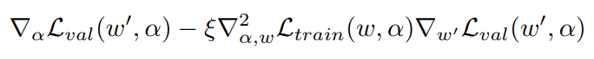
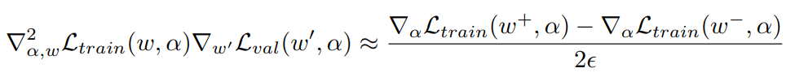
1. Summary
Approximation that significantly reduces search cost
Notes:
25

Slide 26
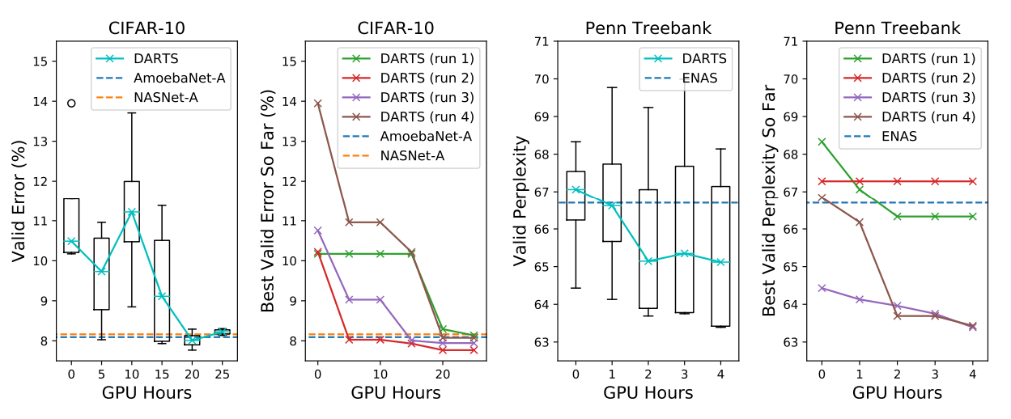
1. Summary
As a result, it outperforms other SOTA algorithms
Notes:
26

Slide 27
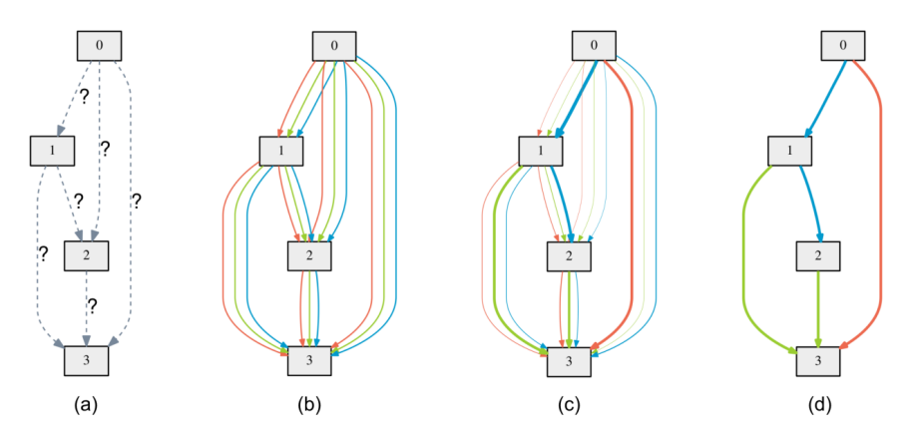
2. Search space
Directed Acyclic Graph
Notes:
27

Slide 28
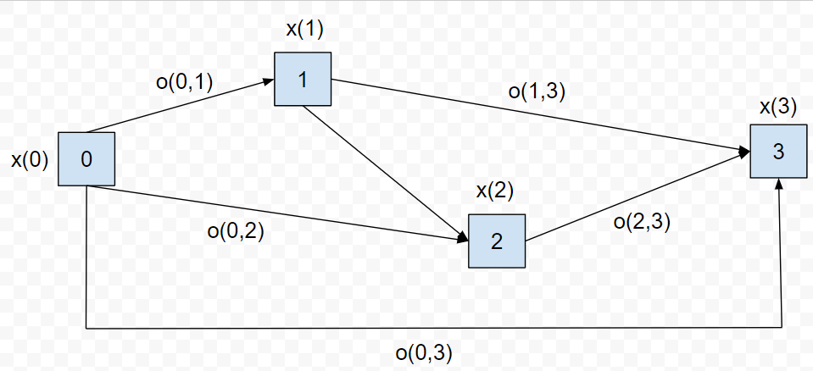
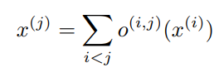
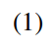
2. Search space
Directed Acyclic Graph
x(i) : input
x(j) : output
o(i,j) : operation (transforms x(i))
Notes:
28

Slide 29
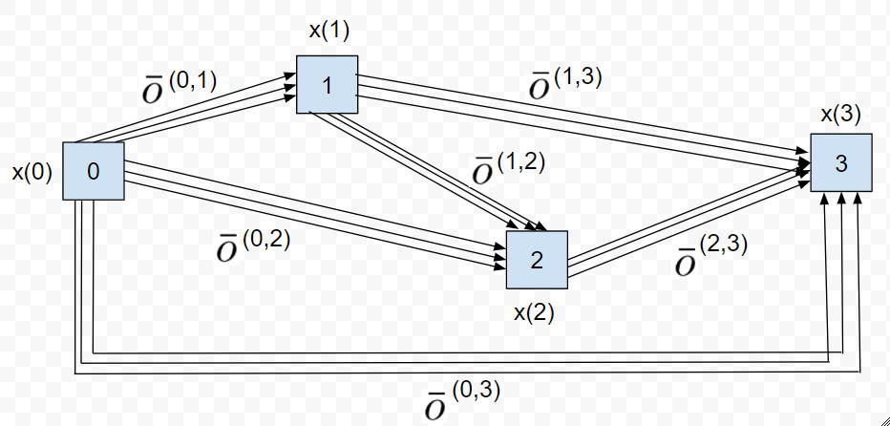
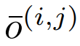
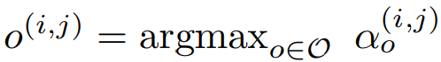
3. Continuous relaxation and optimization
The task of architecture search then reduces to learning a set of continuous variables α = { α (i,j) }
At the end of the search, replace
with
Notes:
29

Slide 30
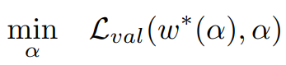
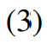
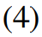
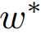
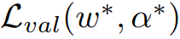
3. Continuous relaxation and optimization
: weight one step after w
Goal is to find α* that minimizes
(4) is bilevel optimization problem
Notes:
30

Slide 31


4. Approximation
: Learning rate for a step of inner optimization
Notes:
31

Slide 32

4. Results
The example shows that a suitable choice of ξ helps to converge to a better local optimum.
Notes:
32

Slide 33
5. Conclusion
Optimization gap
discrepancies between the continuous architecture encoding and the derived discrete architecture.
This could be alleviated by annealing the softmax temperature (with a suitable schedule) to enforce one-hot selection.
Performance-aware architecture derivation schemes based on the shared parameters learned during the search process.
Notes:
33

